Slide 1
ITNW 1335 Cloud Computing
Chapter 4 – Fundamental concepts and models

Slide 2
4.1. Roles and Boundaries
Organizations and humans can assume different types of pre-defined roles depending on how they relate to and/or interact with a cloud and its hosted IT resources
Cloud Provider role:
making cloud services available to cloud consumers, as per agreed upon SLA guarantees
tasked with any required management and administrative duties to ensure the on-going operation of the overall cloud infrastructure
Owns the IT resources that’s made available for lease
May also resell IT resources from other providers

Slide 3
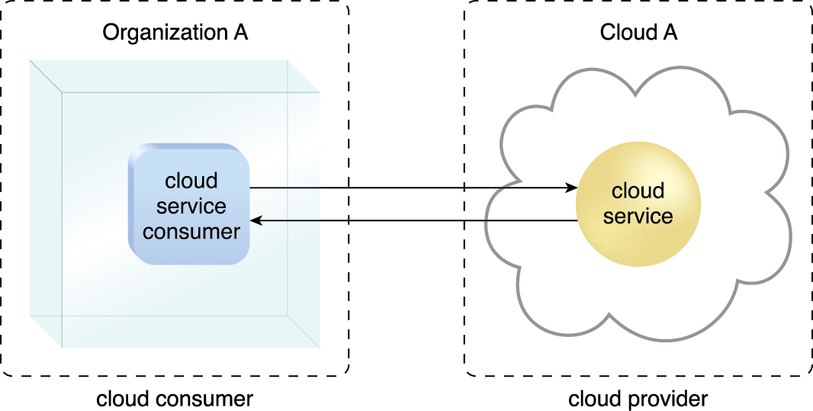
4.1. Roles and Boundaries - Cloud Consumer
Cloud consumer
Org or human that has a formal contract with provider to use IT resources
Figure 4.1 A cloud consumer (Organization A) interacts with a cloud service from a cloud provider
(that owns Cloud A). Within Organization A, the cloud service consumer is being used to
access the cloud service.
Notes:
Figure:

Slide 4
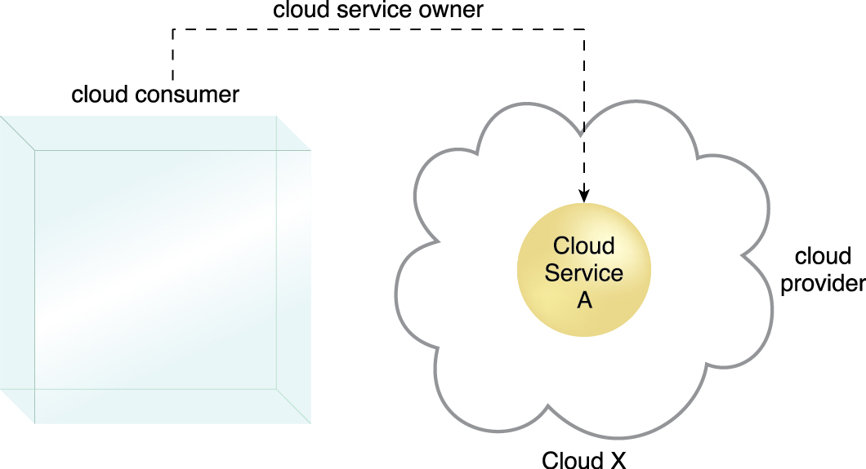
4.1. Roles and Boundaries - Cloud Service owner
The person or organization that legally owns a cloud service is called a cloud service owner
The cloud service owner can be the cloud consumer, or the cloud provider that owns the cloud within which the cloud service resides.
Figure 4.2 A cloud consumer can be a cloud service owner when it deploys its own service in a cloud.
Notes:
Figure:

Slide 5
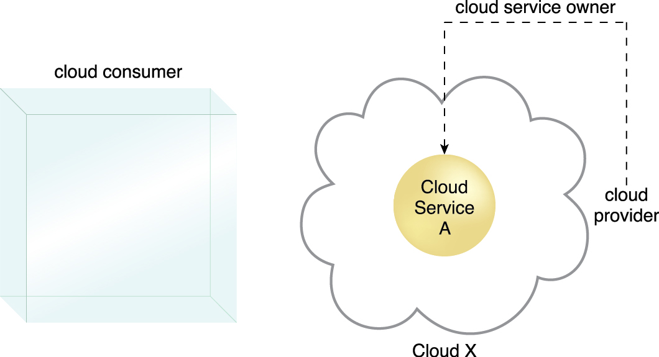
4.1. ROLES AND BOUNDARIES - CLOUD SERVICE OWNER
A cloud provider becomes a cloud service owner if it deploys its own cloud service typically for other cloud consumers to use.
A cloud consumer that owns a service may not necessarily use that service.
Some consumer organization developed cloud services for the general public
The reason a cloud service owner is not called a cloud resource owner is because the cloud service owner role only applies to cloud services
Figure 4.3 A cloud provider becomes a cloud service owner if it deploys its own cloud service, typically for other cloud consumers to use.
Notes:
Figure:

Slide 6
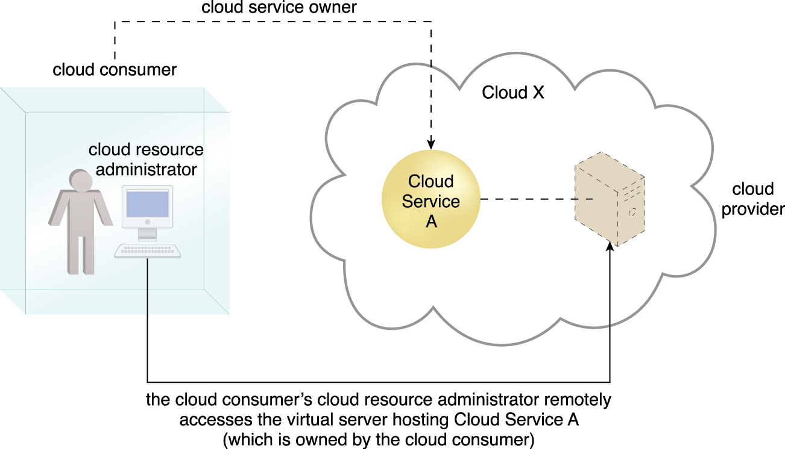
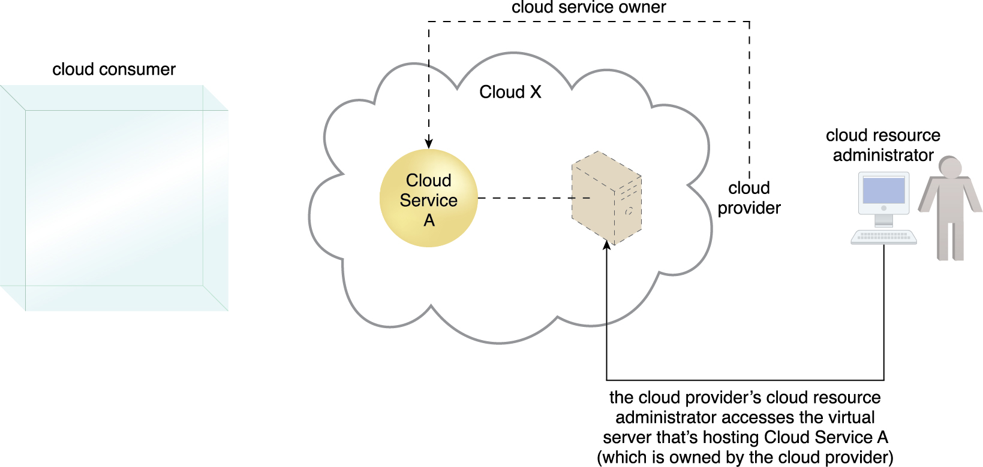
4.1. ROLES AND BOUNDARIES - Cloud Resource Administrator
A cloud resource administrator is the person or organization responsible for administering a cloud-based IT resource (including cloud services)
The cloud resource administrator can be (or belong to) the cloud consumer or cloud provider of the cloud within which the cloud service resides.
Alternatively, it can be (or belong to) a third-party organization contracted to administer the cloud-based IT resource.
Figure 4.4 A cloud resource administrator can be with a cloud consumer organization and administer remotely accessible IT resources that belong to the cloud consumer.
Figure 4.5 A cloud resource administrator can be with a cloud provider organization for which it can administer the cloud provider’s internally and externally available IT resources.
Notes:
Figure:

Slide 7
4.1. ROLES AND BOUNDARIES - Cloud Resource Administrator
The reason a cloud resource administrator is not referred to as a “cloud service administrator” is because this role may be responsible for administering cloud-based IT resources that don’t exist as cloud services.
For example, if the cloud resource administrator belongs to (or is contracted by) the cloud provider, IT resources not made remotely accessible may be administered by this role (and these types of IT resources are not classified as cloud services)
Notes:
Figure:

Slide 8
4.1. ROLES AND BOUNDARIES – Additional Roles
The NIST Cloud Computing Reference Architecture defines the following supplementary roles:
Cloud Auditor – An accredited third-party that conducts independent assessments of cloud environments
Responsibilities are the evaluation of security controls, privacy impacts, and performance.
Main purpose is to provide an unbiased assessment (and possible endorsement) of a cloud environment to help strengthen the trust relationship between cloud consumers and cloud providers.
Cloud Broker – Assumes the responsibility of managing and negotiating the usage of cloud services between cloud consumers and cloud providers
Mediation services provided by cloud brokers include service intermediation, aggregation, and arbitrage.
Cloud Carrier – The party responsible for providing the wire-level connectivity between cloud consumers and cloud providers assumes the role of the cloud carrier. This role is often assumed by network and telecommunication providers.
Notes:
Figure:

Slide 9
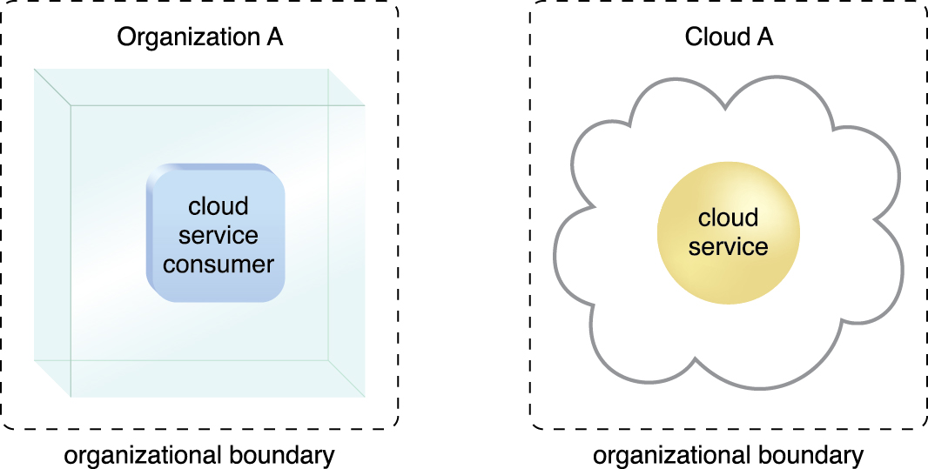
4.1. ROLES AND BOUNDARIES – Organizational Boundary
An organizational boundary represents the physical perimeter that surrounds a set of IT resources that are owned and governed by an organization
Does not represent the boundary of an actual organization, only an organizational set of IT assets and IT resources.
Figure 4.6 Organizational boundaries of a cloud consumer (left), and a cloud provider (right),
represented by a broken line notation.
Notes:
Figure:

Slide 10
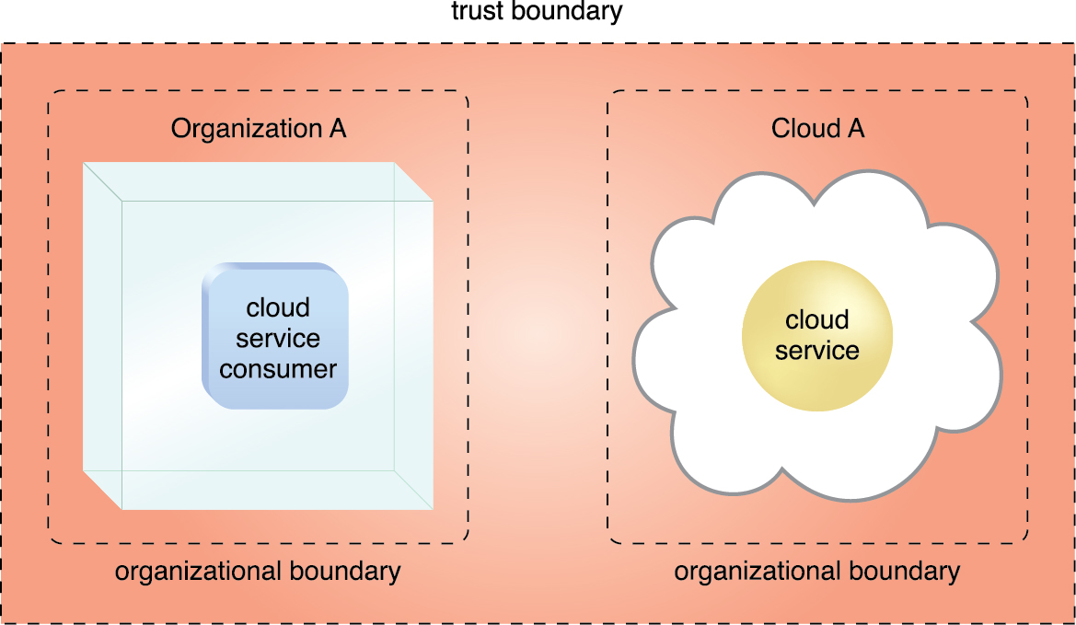
4.1. ROLES AND BOUNDARIES – Trust Boundary
A trust boundary is a logical perimeter that typically spans beyond physical boundaries to represent the extent to which IT resources are trusted
When analyzing cloud environments, the trust boundary is most frequently associated with the trust issued by the organization acting as the cloud consumer
Figure 4.7 An extended trust boundary encompasses the organizational boundaries of the cloud provider and the cloud consumer.
Notes:
Figure:

Slide 11
4.2. Cloud Characteristics
An IT environment requires a specific set of characteristics to enable the remote provisioning of scalable and measured IT resources in an effective manner
These characteristics need to exist for the IT environment to be considered an effective cloud.
The following six specific characteristics are common to the majority of cloud environments:
on-demand usage
ubiquitous access
multitenancy (and resource pooling)
elasticity
measured usage
Resiliency
These characteristics can be assessed individually and collectively to measure the value offering of a given cloud platform
The greater the degree to which they are supported and utilized, the greater the resulting value proposition.

Slide 12
4.2. Cloud Characteristics
On Demand Usage
Consumer can configure self-provisioned IT resources automatically without further involvement
This characteristic enables the service-based and usage-driven features found in mainstream clouds.
Ubiquitous Access
The ability for a cloud service to be widely accessible
Establishing ubiquitous access for a cloud service can require support for a range of devices, transport protocols, interfaces, and security technologies.
Think PC vs Phone vs Mac vs Windows, etc

Slide 13
Multitenancy (and Resource Pooling)
Multitenancy
characteristic of a software program that enables an instance of the program to serve different consumers (tenants) whereby each is isolated from the other
Provider pools IT resources for consumers via virtualization technologies
IT resources can be dynamically assigned and reassigned via multitenancy technologies per cloud service consumer demands
Uses statistical multiplexing
Notes:
Figure:

Slide 14
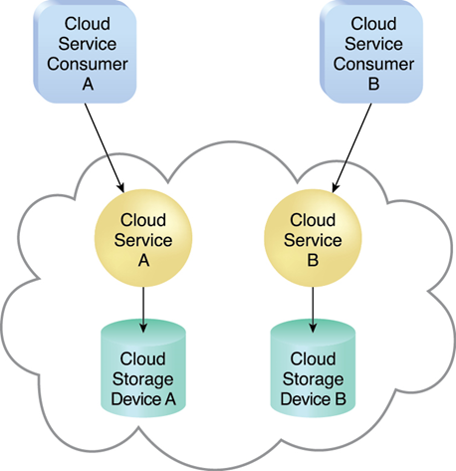
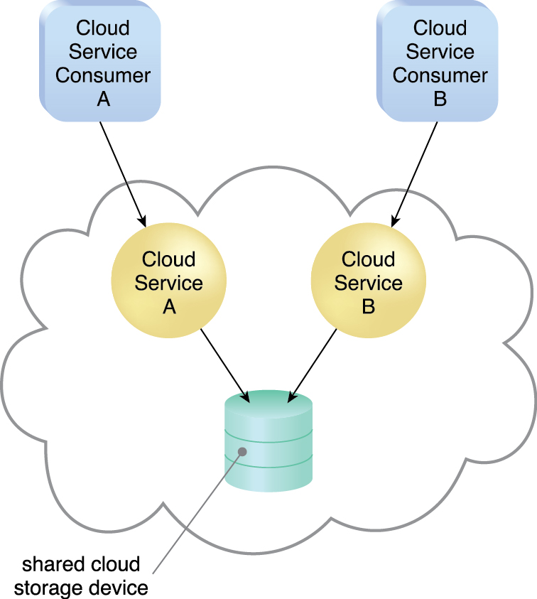
Multitenancy (and Resource Pooling)
Figure 4.8 In a single-tenant environment, each cloud consumer has a separate IT resource instance.
Figure 4.9 In a multitenant environment, a single instance of an IT resource, such as a cloud storage device, serves multiple consumers.
Notes:
Figure:

Slide 15
4.2. Cloud Characteristics
Elasticity
Automated ability of a cloud to transparently scale IT resources, as required in response to runtime conditions or as pre-determined by the cloud consumer or cloud provider
Often considered a core justification for the adoption of cloud computing, primarily due to the fact that it is closely associated with the Reduced Investment and Proportional Costs benefit
Measure Usage
the ability of a cloud platform to keep track of the usage of its IT resources, primarily by cloud consumers
Based on what is measured, the cloud provider can charge a cloud consumer only for the IT resources actually used and/or for duration
Closely related to the on-demand characteristic
not limited to tracking statistics for billing purposes
It also encompasses the general monitoring of IT resources and related usage reporting (for both cloud provider and cloud consumers

Slide 16
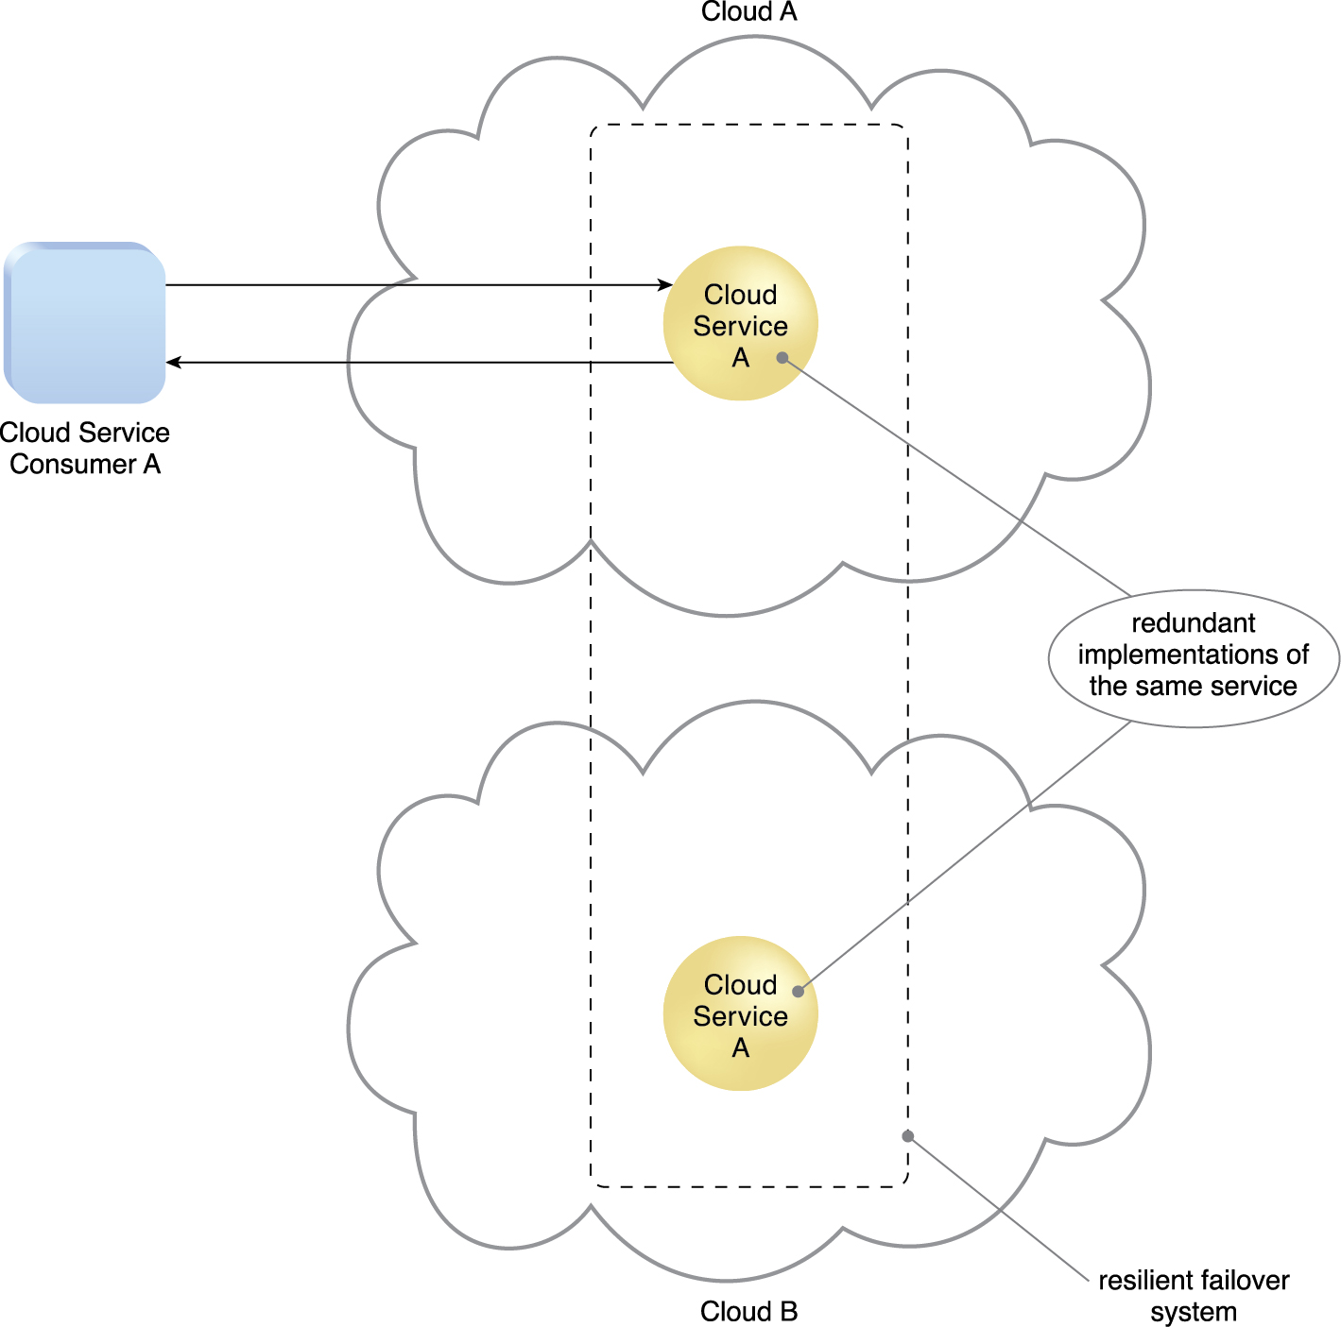
4.2. Cloud Characteristics - Resiliency
Resilient computing is a form of failover that distributes redundant implementations of IT resources across physical locations.
IT resources can be pre-configured so that if one becomes deficient, processing is automatically handed over to another redundant implementation
Within cloud computing, the characteristic of resiliency can be within the same cloud (but in different physical locations) or across multiple clouds
Cloud consumers can increase both the reliability and availability of their applications by leveraging the resiliency of cloud-based IT resources
Figure 4.10 A resilient system in which Cloud B hosts a redundant implementation of Cloud Service A to provide failover in case Cloud Service A on Cloud A becomes unavailable.
Notes:
Figure:

Slide 17
4.3. Cloud Delivery Models
A cloud delivery model represents a specific, pre-packaged combination of IT resources offered by a cloud provider
Three common cloud delivery models have become widely established and formalized:
Infrastructure-as-a-Service (IaaS)
Platform-as-a-Service (PaaS)
Software-as-a-Service (SaaS)
Specialized variations of the three base cloud delivery models have emerged
Storage-as-a-Service
Database-as-a-Service
Security-as-a-Service
Communication-as-a-Service – VoIP, Video Conference
Integration-as-a-Service – combines services (cloud and on-prem) for small and mid-size businesses
Testing-as-a-Service - automated regression testing, performance testing, security testing, application testing
Process-as-a-Service - payroll, printing, ecommerce

Slide 18
4.3. Cloud Delivery Models: Infrastructure-as-a-Service (IaaS)
The IaaS delivery model represents a self-contained IT environment comprised of infrastructure-centric IT resources that can be accessed and managed via cloud service-based interfaces and tools
This environment can include hardware, network, connectivity, operating systems, and other “raw” IT resources
IT resources are typically virtualized and packaged into bundles that simplify up-front runtime scaling and customization of the infrastructure
The general purpose of an IaaS environment is to provide cloud consumers with a high level of control and responsibility over its configuration and utilization
Resources are generally not preconfigured, placing the administrative responsibility directly upon the cloud consumer.
Require a high level of control, by consumer, over the cloud-based environment they intend to create

Slide 19
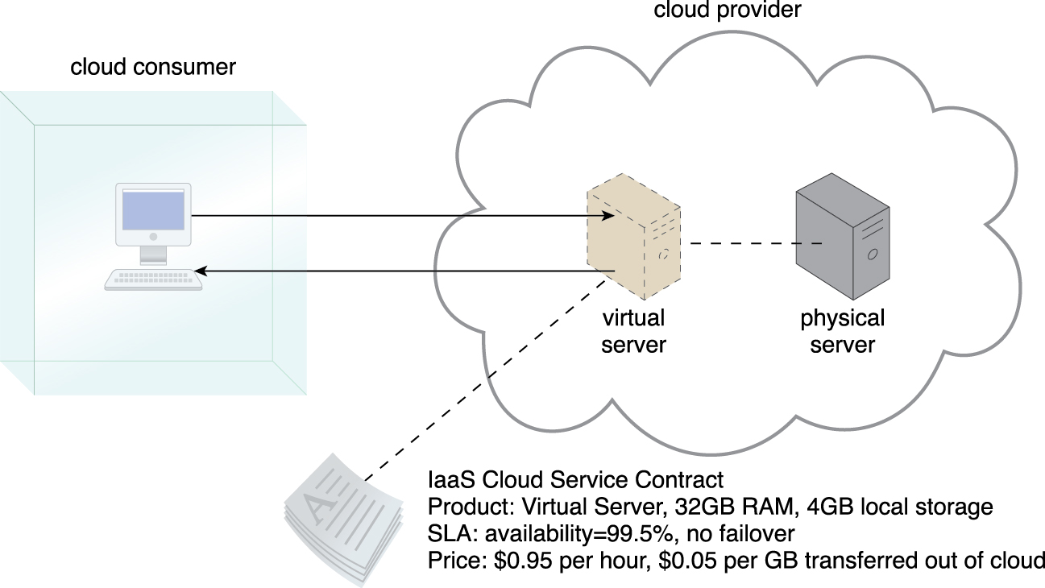
4.3. Cloud Delivery Models: Infrastructure-as-a-Service (IaaS)
IT resources available through IaaS environments are generally offered as freshly initialized virtual instances
A central and primary IT resource within a typical IaaS environment is the virtual server
Virtual servers are leased by specifying server hardware requirements, such as processor capacity, memory, and local storage space
IaaS examples: AWS EC2, Rackspace, Google Compute Engine (GCE), Digital Ocean, Magento 1 Enterprise Edition
Figure 4.11 A cloud consumer is using a virtual server within an IaaS environment. Cloud consumers are provided with a range of contractual guarantees by the cloud provider, pertaining to characteristics such as capacity, performance, and availability.
Notes:
Figure:

Slide 20
4.3. Cloud Delivery Models: Platform-as-a-Service (PaaS)
The PaaS delivery model represents a pre-defined “ready-to-use” environment typically comprised of already deployed and configured IT resources
PaaS relies on the usage of a ready-made environment that establishes a set of pre-packaged products and tools used to support the entire delivery lifecycle of custom applications.
Common reasons to use and invest in a PaaS environment include:
The cloud consumer wants to extend on-premise environments into the cloud for scalability and economic purposes
The cloud consumer uses the ready-made environment to entirely substitute an on-premise environment.
The cloud consumer wants to become a cloud provider and deploys its own cloud services to be made available to other external cloud consumers.

Slide 21
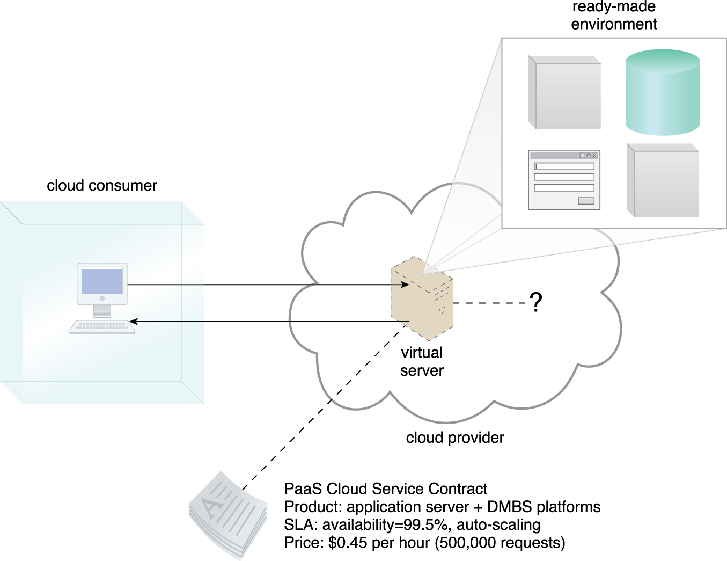
4.3. Cloud Delivery Models: Platform-as-a-Service (PaaS)
With PaaS, the cloud consumer is spared the administrative burden of setting up and maintaining the bare infrastructure IT resources provided via the IaaS model
Conversely, the cloud consumer is granted a lower level of control over the underlying IT resources that host and provision the platform
PaaS products are available with different development stacks
PaaS examples: AWS Elastic Beanstalk, Heroku, Windows Azure (mostly used as PaaS), Force.com, OpenShift, Apache Stratos, Magento Commerce Cloud
Figure 4.12 A cloud consumer is accessing a ready-made PaaS environment. The question mark indicates that the cloud consumer is intentionally shielded from the implementation details of the platform.
Notes:
Figure:

Slide 22
4.3. Cloud Delivery Models: Software-as-a-Service (SaaS)
A software program positioned as a shared cloud service and made available as a “product” or generic utility
Used to make a reusable cloud service widely available (often commercially) to a range of cloud consumers
An entire marketplace exists around SaaS products that can be leased and used for different purposes and via different terms
Consumer is granted very limited administrative control over a SaaS implementation
It is most often provisioned by the cloud provider, but it can be legally owned by whichever entity assumes the cloud service owner role.
an organization acting as a cloud consumer while using and working with a PaaS environment can build a cloud service that it decides to deploy in that same environment as a SaaS offering

Slide 23
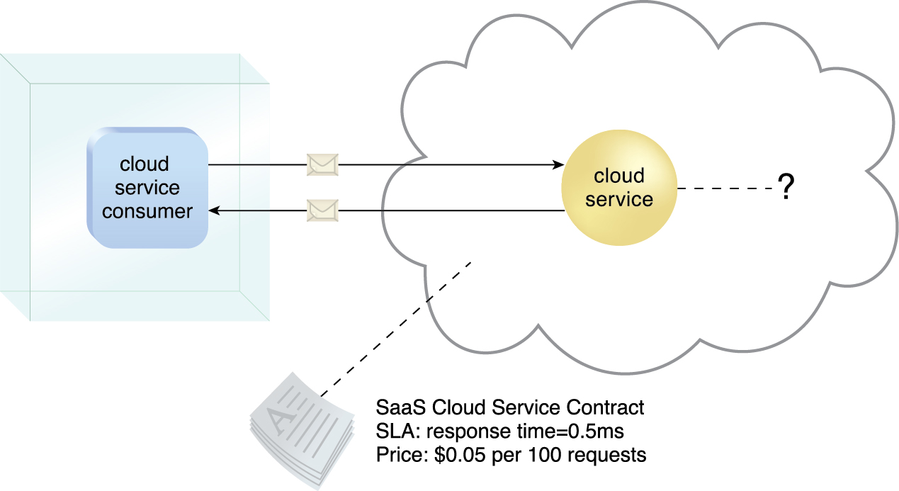
4.3. Cloud Delivery Models: Software-as-a-Service (SaaS)
SaaS examples: BigCommerce, Google Apps, Salesforce, Dropbox, MailChimp, ZenDesk, DocuSign, Slack, Hubspot
Figure 4.13 The cloud service consumer is given access the cloud service contract, but not to any
underlying IT resources or implementation details.
Notes:
Figure:

Slide 24
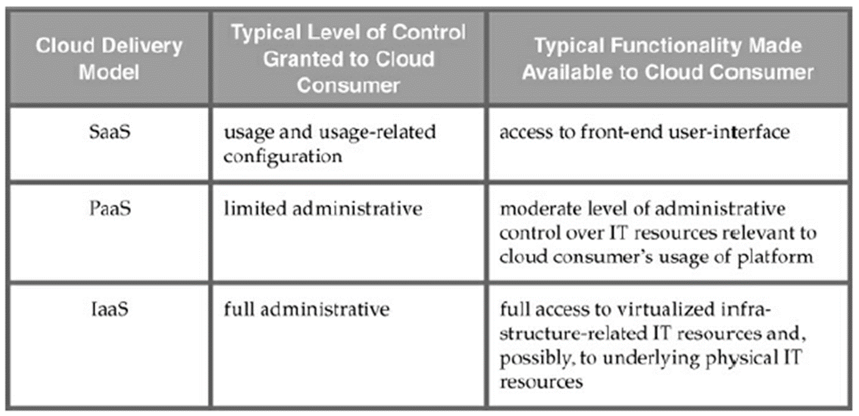
4.3. Cloud Delivery Models: Comparing Cloud Delivery Models
Table 4.1 A comparison of typical cloud delivery model control levels.

Slide 25
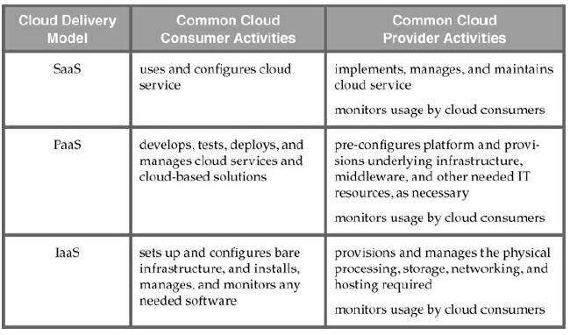
4.3. Cloud Delivery Models: Comparing Cloud Delivery Models
Table 4.2 Typical activities carried out by cloud consumers and cloud providers in relation to the cloud delivery models.

Slide 26
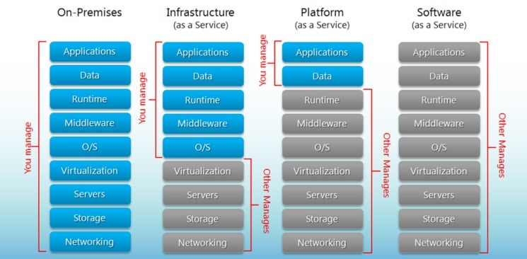
Comparing Cloud Delivery Models
Consumer vs Provider responsibilities.

Slide 27
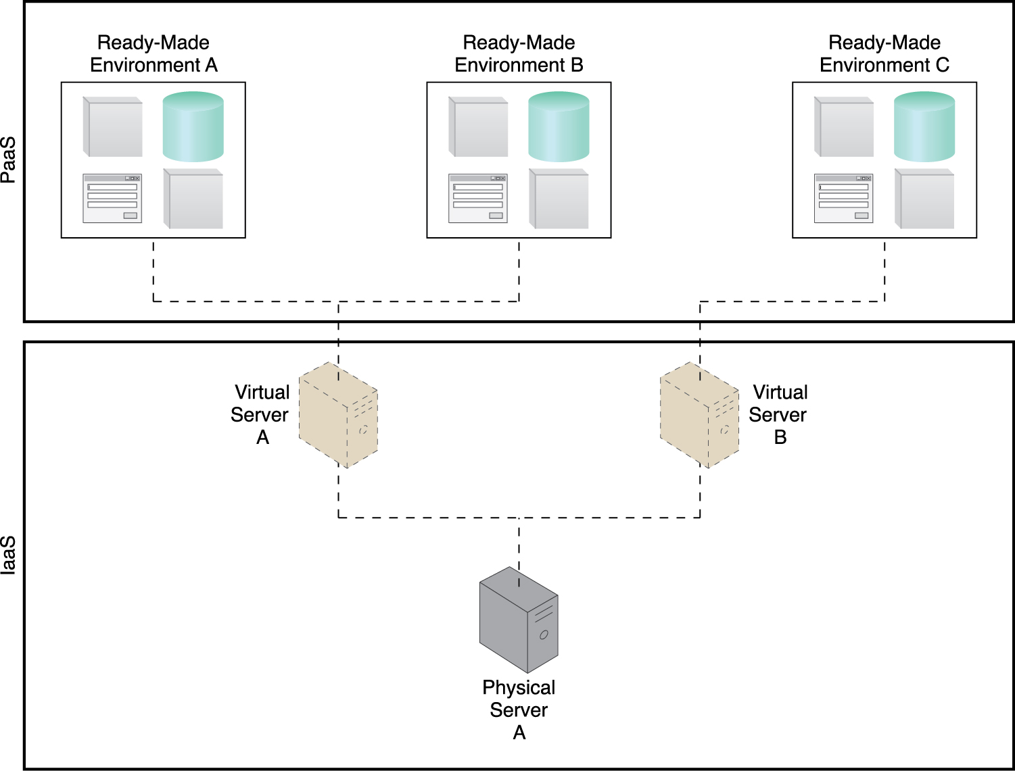
4.3. Cloud Delivery Models: Combining Cloud Delivery Models - IaaS + PaaS
The three base cloud delivery models comprise a natural provisioning hierarchy, allowing for opportunities for the combined application of the models to be explored
PasS environment is built on underlying infrastructure provided in a IaaS environment
Not normally necessary from an IaaS provider in order to make a PaaS environment.
Figure 4.14 A PaaS environment based on the IT resources provided by an underlying IaaS environment.
Notes:
Figure:

Slide 28
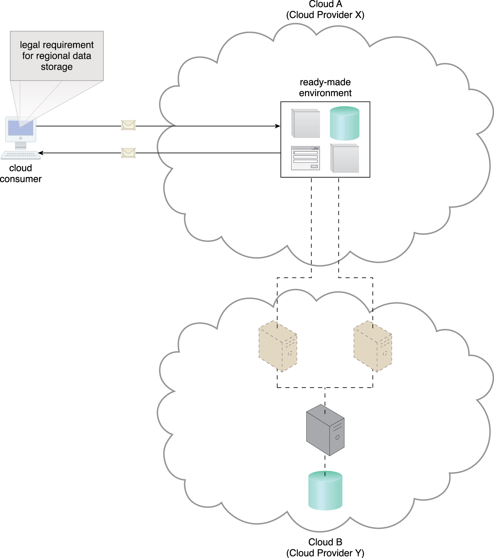
4.3. Cloud Delivery Models: Combining Cloud Delivery Models - IaaS + PaaS
In this case, PaaS provider chooses to lease the IaaS from another cloud provider due to:
Economics
Capacity constraints
Legal requirement from cloud consumer where data has to remain regional.
Figure 4.15 An example of a contract between Cloud Providers X and Y, in which services offered by Cloud Provider X are physically hosted on virtual servers belonging to Cloud Provider Y. Sensitive data that is legally required to stay in a specific region is physically kept in Cloud B, which is physically located in that region.
Notes:
Figure:

Slide 29
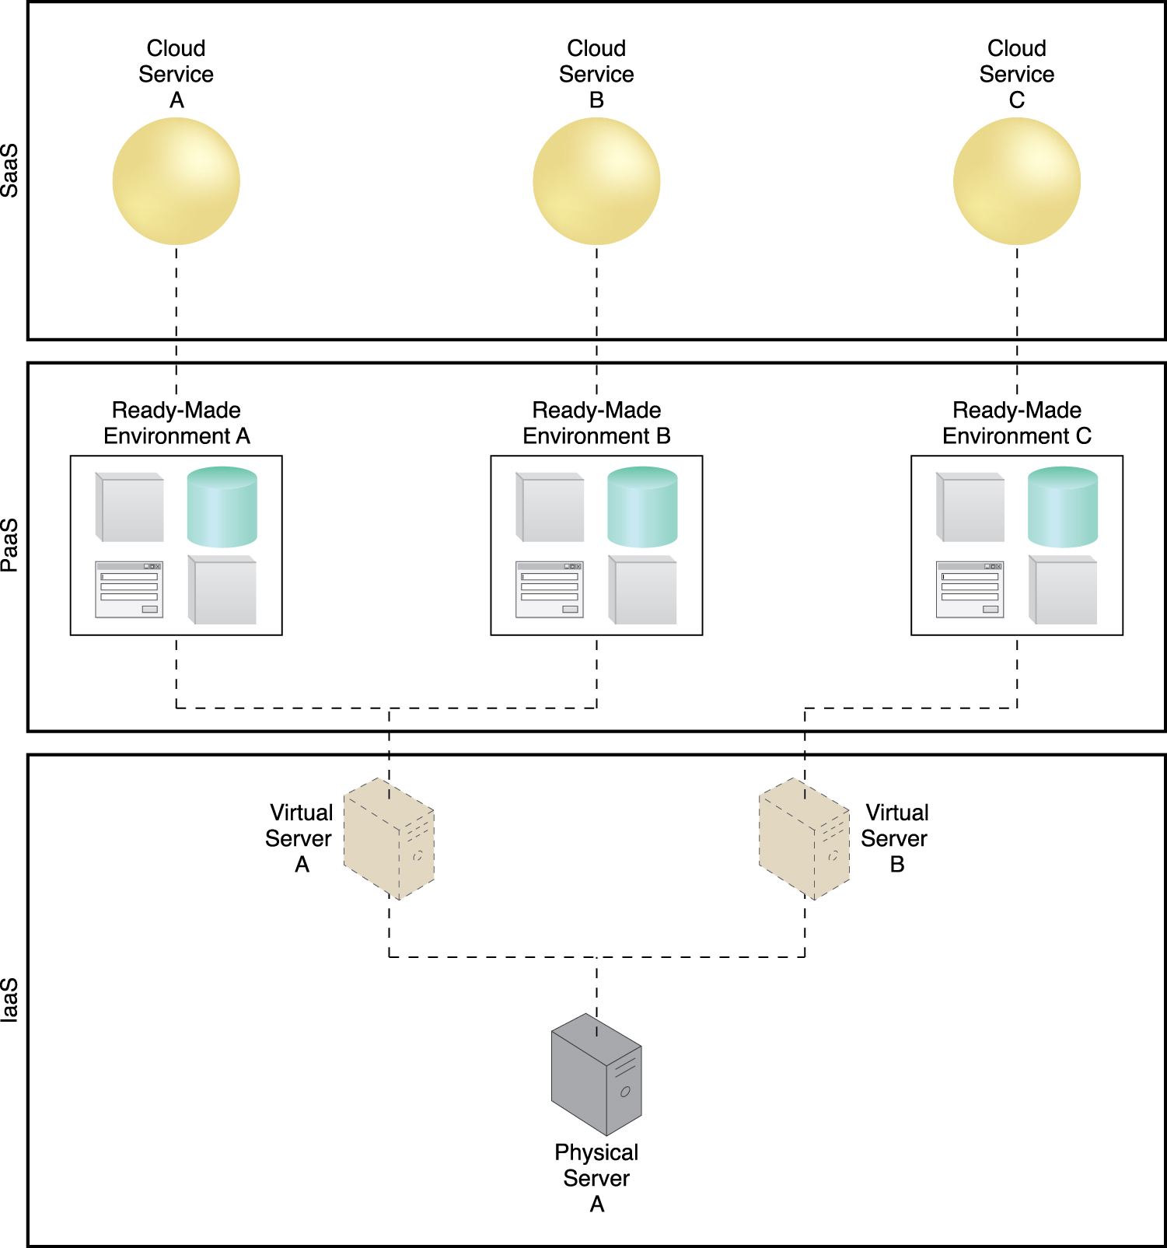
4.3. Cloud Delivery Models: Combining Cloud Delivery Models - IaaS + PaaS + SaaS
All three cloud delivery models can be combined to establish layers of IT resources that build upon each other
The ready-made environment provided by the PaaS environment can be used by the cloud consumer organization to develop and deploy its own SaaS cloud services that it can then make available as commercial product
Figure 4.16 A simple layered view of an architecture comprised of IaaS and PaaS environments
hosting three SaaS cloud service implementations.
Notes:
Figure:

Slide 30
4.4. Cloud Deployment Models
A cloud deployment model represents a specific type of cloud environment, primarily distinguished by ownership, size, and access
There are four common cloud deployment models:
Public cloud
Community cloud
Private cloud
Hybrid cloud

Slide 31
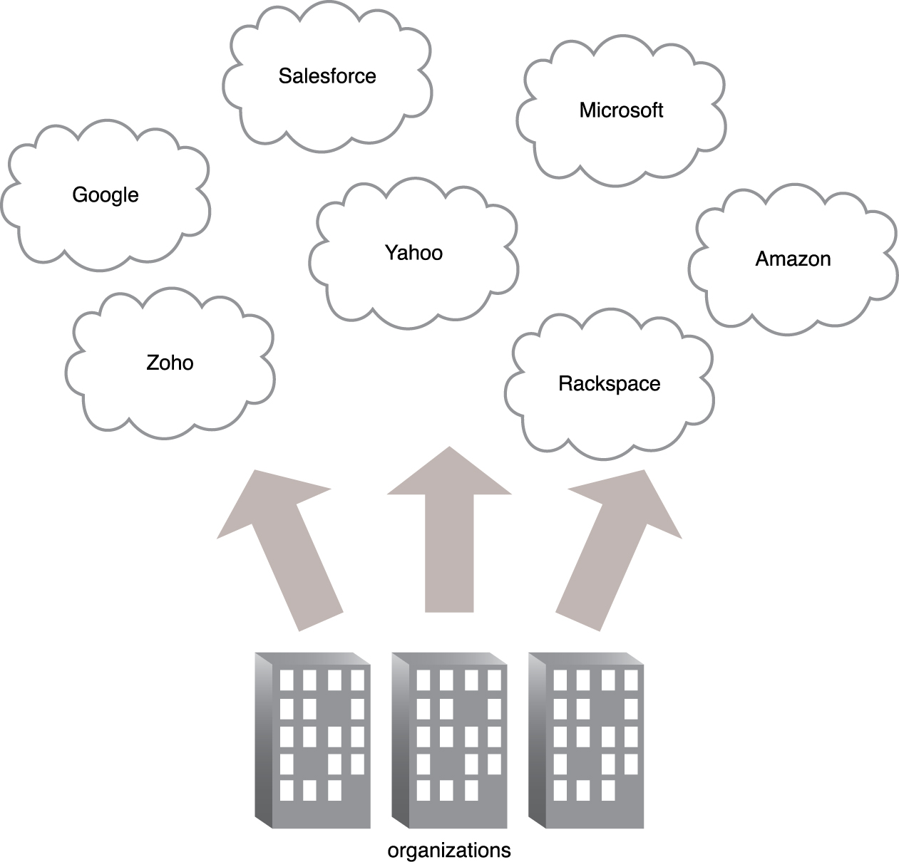
4.4. Cloud Deployment Models – Public Clouds
A public cloud is a publicly accessible cloud environment owned by a third-party cloud provider.
The IT resources on public clouds are usually provisioned via the previously described cloud delivery models and are generally offered to cloud consumers at a cost or are commercialized via other avenues (such as advertisement).
The cloud provider is responsible for the creation and on-going maintenance of the public cloud and its IT resources
Figure 4.17 Organizations act as cloud consumers when accessing cloud services and IT resources
made available by different cloud providers.
Notes:
Figure:

Slide 32
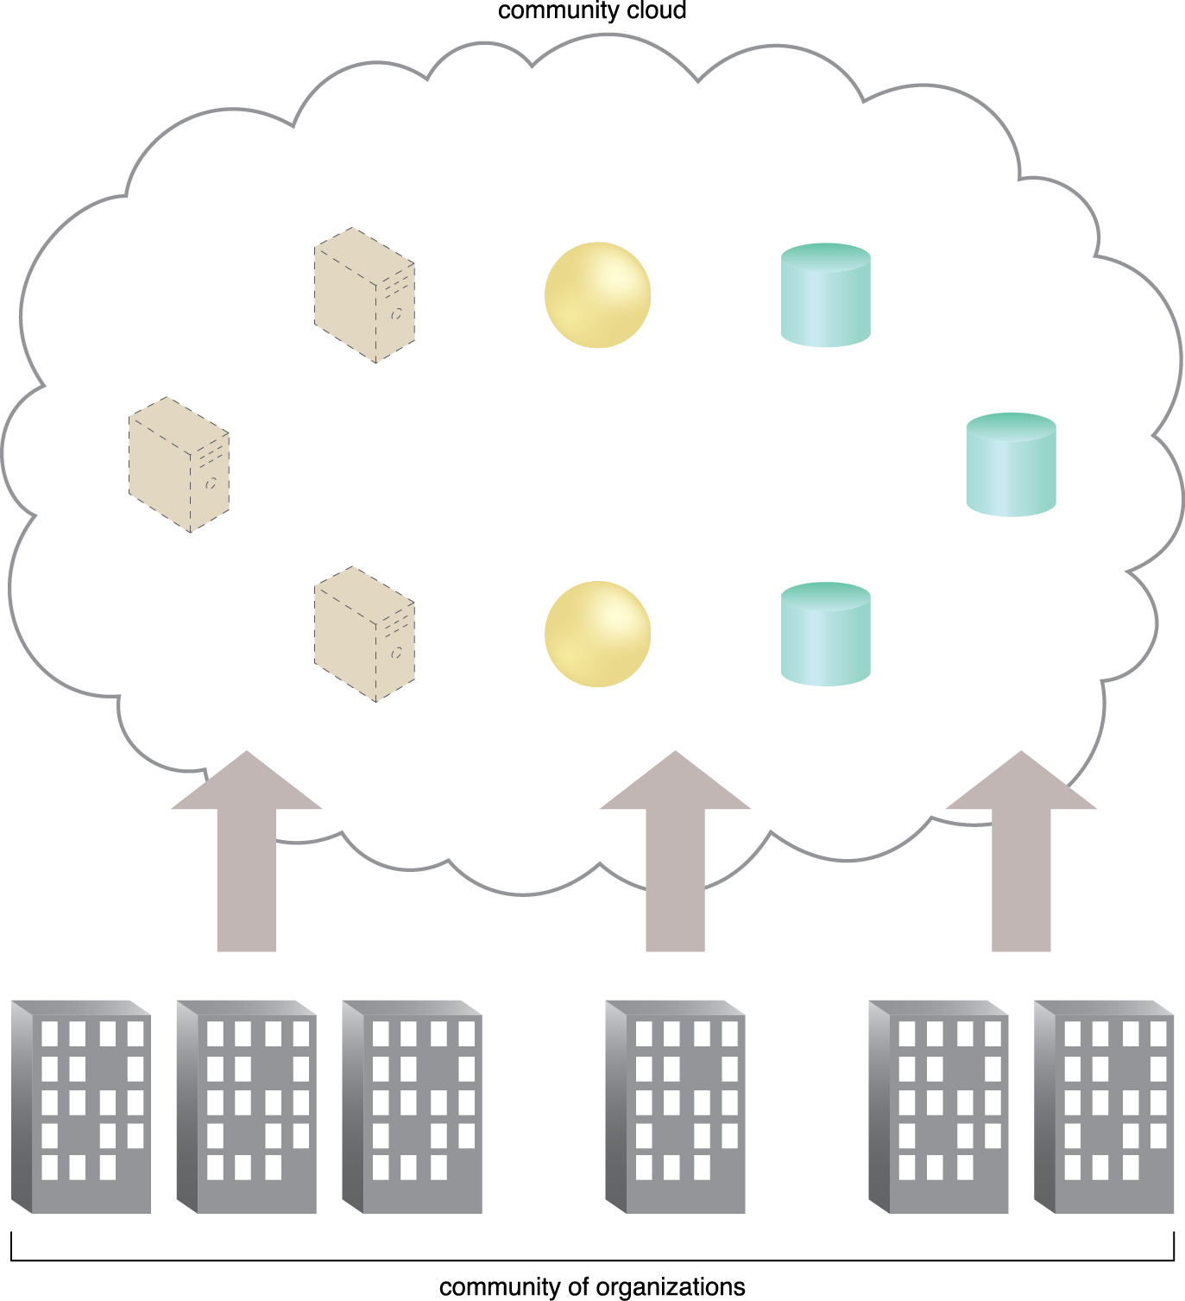
4.4. Cloud Deployment Models – Community Clouds
A community cloud is similar to a public cloud except that its access is limited to a specific community of cloud consumers
The community cloud may be jointly owned by the community members or by a third-party cloud provider that provisions a public cloud with limited access
The member cloud consumers of the community typically share the responsibility for defining and evolving the community cloud
Membership in the community does not necessarily guarantee access to or control of all the cloud’s IT resources
Outsides are not granted access
Figure 4.18 An example of a “community” of organizations accessing IT resources from a community cloud.
Notes:
Figure:

Slide 33
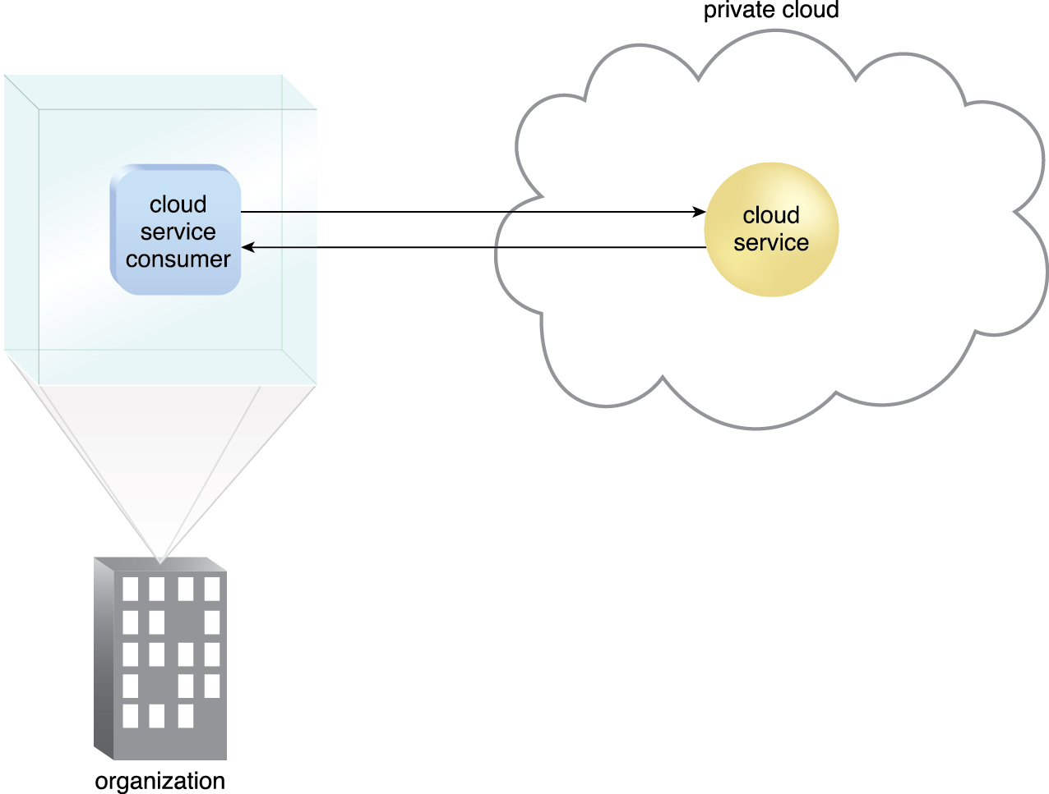
4.4. Cloud Deployment Models – Private Clouds
Owned by a single organization
Used by orgs to centralize IT resources
Risk and challenges of other models don’t apply
Same org is technically both consumer and provider
Roles can be differentiated
Still use the terms “on-premise” and “cloud based” even though all resources reside on-premise
Figure 4.19 A cloud service consumer in the organization’s on-premise environment accesses a cloud service hosted on the same organization’s private cloud via a virtual private network.
Notes:
Figure:

Slide 34
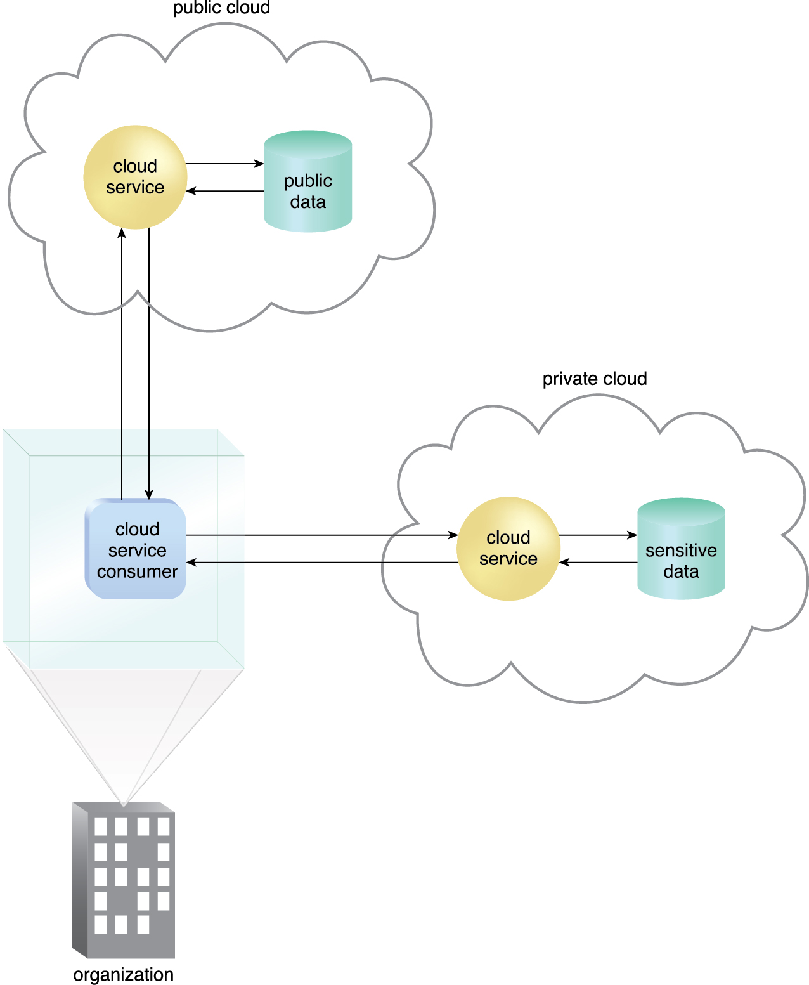
4.4. Cloud Deployment Models – Hybrid Clouds
A hybrid cloud is a cloud environment comprised of two or more different cloud deployment models.
For example, a cloud consumer may choose to deploy cloud services processing sensitive data to a private cloud and other, less sensitive cloud services to a public cloud
Can be complex and challenging to create and maintain
Disparity in cloud environments
Split management responsibilities
Figure 4.20 An organization using a hybrid cloud architecture that utilizes both a private and public cloud.
Notes:
Figure:

Slide 35
Other Cloud Deployment Models
Additional variations of the four base cloud deployment models can exist.
Examples include:
Virtual Private Cloud – Also known as a “dedicated cloud” or “hosted cloud,” this model results in a self-contained cloud environment hosted and managed by a public cloud provider, and made available to a cloud consumer.
Inter-Cloud – This model is based on an architecture comprised of two or more inter-connected clouds.

